Slide 1
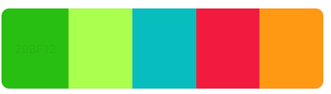
29BF12
ABFF4F
08BDBD
F21B3F
FF9914

Slide 2
Index
COA
C++
Statistics
Machine Learning

Slide 3
DSA

Slide 4
_{Algorithm to study}
Trees
Kruskal : set of vertices
Prims
Dijiktras
Belmann ford
Travelling salesman
knapsack
A algorithm
Floyd-Warshalls

Slide 5
COA

Slide 6
_{Intro}
The Computer how is presented to programmer Is its architecture & how its actually composed what all parts are working in it is its organization,
There are two famous

Slide 7
_{Assembly}
The term “Assembly language” refers to the family of LLL that is the nearest language to machine code , Assembly language depends on ISAs
one instruction of HLL = 6,7,8.. No of machine level instruction
1 assembly instruction = 1 machine level instruction
Why to learn assembly language
Write highly efficient code suitable for core parts of game & mission critical softwares
To program for OS & device driver
Use features of machine that are not supported by a standard programming language
Assembler converts assembly code to machine code (0s & 1s x)
Nasm , Tasm, Masm are assemblers for x86 architecture.
In linux “g++ -S filename” gives assembly code , you can open it in text editor
Lets discuss bit about memory
basically memory is large array of bytes used to store data
There are 2 convention to store
Little endian -> LSB at low memory location (ARM & intel)
Big endian -> LSB at big memory location (Sun sparc ,IBM PPC)
The 2d array can be stored in row major (C , Pyhton), column major form (matlab ,Fortran).

Slide 8
ASSEMBLY file structure (GNU Assembler)
We are discussing general assembly file structure (small change can be there os to os )
Assembly file is divided into 3 section.
.file : name of source file
.text : contains the list of instruction
.data : data used by program as read only variable , constants etc
_{Statement structure}
instruction
Operand 1
Operand 2
Operand 3
Instruction : mnemonics for machine instruction
Operand : can be register , constant , memory location
Constant (also known as immediate)
Register
Memory location

Slide 9
_{Assembly Language Syntax}
Types of Instruction
Data Processing
Data transfer
Branch
Special :interaction with peripheral devices, machine specific instruction
----------------------------------------------------------------------------------------------------------------------------
Notations
r will represent the register
[] around anything represent that it is a memory location ie [r5] means the value in r5 is a memory location & [r5] is equal to data in that memory location.
r2 <- r1 means transfer the content of r2 to r1.
----------------------------------------------------------------------------------------------------------------------------
Addressing Mode
Immediate : it simply means using a constant directly as operand.
Register direct : using the value stored in register as an operand .
Register Indirect : where the value stored in register is used as a memory address to fetch the data. Eg [r5] where r5 is used as memory address.
Base-offset : [r5 + offset] in assembly [r5+4] is written as 4[r5]
------------------------------------------------------------------------------------------------------------------------------
More Addressing Mode
You will frequently find this modes in x86
Base-Index-offset : 100[r1,r2] -> [r1+r2+100]
Memory Direct : we need to fetch the data from memory to register , but in this addressing mode the data is not required to be fetched into register rather can directly work as operand
PC relative : you will be offset to PC value rather than the register
eg [PC + Offset] is represented as offset[PC] , 5[PC] ->[PC + 5]

Slide 10
_{Simple Risc ISA}
Types of Instruction
Data Processing
Data transfer
Branch
Special :interaction with peripheral devices, machine specific instruction
----------------------------------------------------------------------------------------------------------------------------
Notations
r will represent the register
[] around anything represent that it is a memory location ie [r5] means the value in r5 is a memory location & [r5] is equal to data in that memory location.
r2 <- r1 means transfer the content of r2 to r1.
----------------------------------------------------------------------------------------------------------------------------
Addressing Mode
Immediate : it simply means using a constant directly as operand.
Register direct : using the value stored in register as an operand .
Register Indirect : where the value stored in register is used as a memory address to fetch the data. Eg [r5] where r5 is used as memory address.
Base-offset : [r5 + offset] in assembly [r5+4] is written as 4[r5]
------------------------------------------------------------------------------------------------------------------------------
More Addressing Mode
You will frequently find this modes in x86
Base-Index-offset : 100[r1,r2] -> [r1+r2+100]
Memory Direct : we need to fetch the data from memory to register , but in this addressing mode the data is not required to be fetched into register rather can directly work as operand
PC relative : you will be offset to PC value rather than the register
eg [PC + Offset] is represented as offset[PC] , 5[PC] ->[PC + 5]

Slide 11
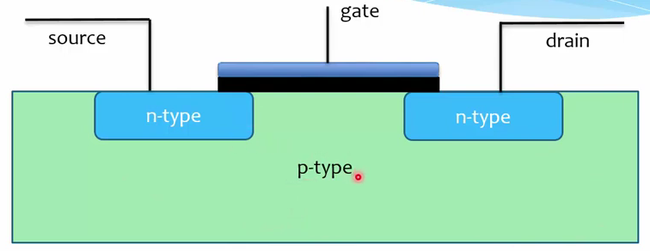
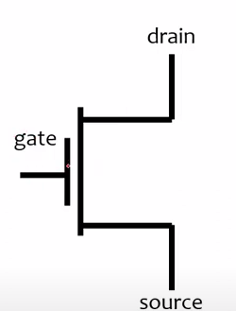
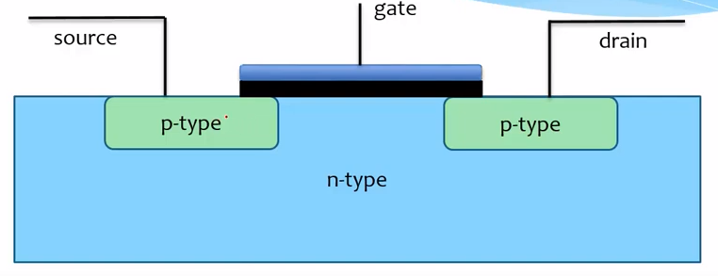
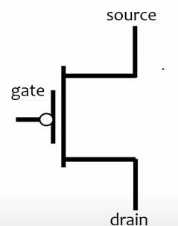
_{Digital Logic}
Note : Current flows opp to direction of electron flow & same direction as holes
When we apply +ve charge to gate,
Holes start flowing from source to drain
When we apply –ve or 0 charge to gate,
electron start flowing from source to drain

Slide 12
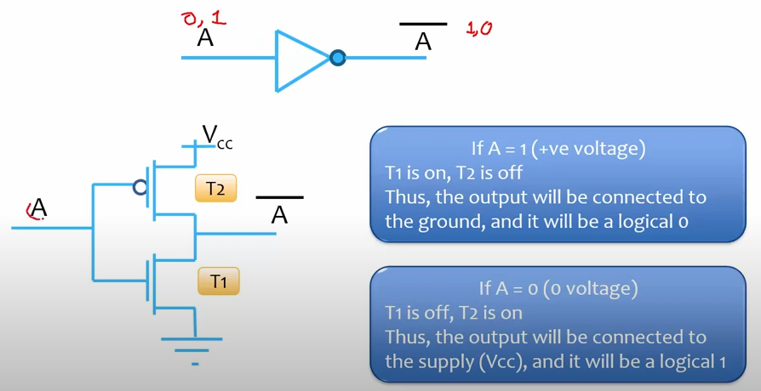
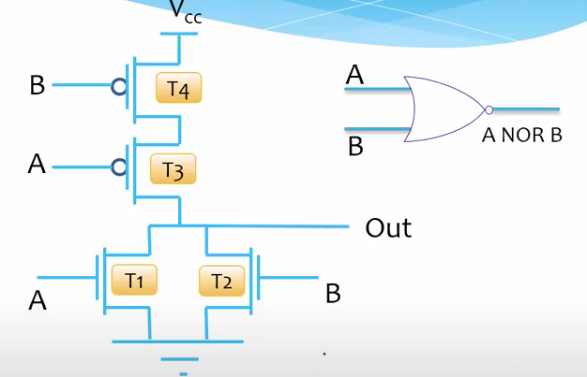
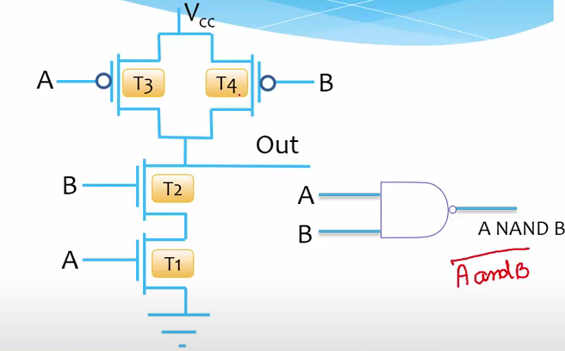
_{Logic Gates}

Slide 13
_{Combinational logic}
In Combinational Logic we saw , Multiplexer , DeMultiPlexer , Encoder , Decoder this all you can see from internet

Slide 14
_{Sequential logic}

Slide 15
_{Memory}

Slide 16
MultiProcessing

Slide 17
_{Asynchronous Operation}
Synchronous Process/execution : A synchronous process is a process where tasks are executed one after another, in a predefined sequence, and each step waits for the previous one to finish before proceeding.
Asynchronous : lets say we have code running on one thread now if one section of code is waiting for any resources (given a request to fetch the data from disc, or waiting for data to come from server etc) this section of code will block the other section from being executed as it will block other code.
Now lets think a code/application as big Process & thread is a worker ,
-> Now as a process owner to make a section of code non-blocking you will put it in one thread ,likewise you do it for multiple section of code,
Here the problem is that all the thread share the same resource (ie resource of the process) & it might lead to race condition between multiple threads, hence some people refrain from using threads. Some do ensuring thread safety (using mutex , semaphore etc)
There are issues (good parts are also there) with implementing multiple threads hence we sometimes go into asynchronous programming ‘
Where the thread is one but operates asynchronously as in if it is waiting for a IO to finish the control os transferred to another sections of code.
Threads: Like hiring multiple employees to do different tasks. Each one needs a desk (resources), and when one is stuck, another can still work.
Async: Like having one fast employee who switches between tasks as soon as one gets stuck (like waiting for an email). Very efficient but can’t do two heavy tasks at once.
Now comes multiprocessing : we rather than creating multiple threads out of a process which share same resources , we can create separate processes with each having its own resource , & those process communicate with each other using inter-process communication (sockets , ports etc), advantage of it is to be able to run each process in different machines n all

Slide 18
C++

Slide 19
_{Syntaxs}
# Pragma once : put this in your file it ensures that the header file is just included one wherever it is called
whichever header has pragma once in them can only be included once anywhere in code .
say 2 files are there A.h & B.h

Slide 20
Linux

Slide 21
ii) Development Tools
In this section we will look , how the C , C++ code is compiled in Linux & How to Compile big Projects.
g++ hello.c (compile & give executable file “a.out”)
g++ -o anyName hello.c (compile & give executable file with name “anyName”)
g++ -c hello.c ( you will get object file with name hello.o )
An object file is a binary file that a processor can almost understand, except that there are still a few loose ends. First, the operating system doesn’t know how to start up an object file, and second, you likely need to combine several object files and some system libraries to make a complete program.
Lets say you have multiple files one file depends on other aux.c & main.c , main is just calling the function in aux.c
g++ -c aux.c
g++ -c main.c (these commands will give object files aux.o & main.o )
Now we need to run the linker with both of these .o files using “ld” command but we rarely use it as the compiler itself knows how to run the linker hence we use the g++ itself
cc -o myprog main.o aux.o (this will give executable file with name “myprog” )
this is just with 2 files imagine if a big project has 100s of file then how will we manage , a solution for this is a make file

Slide 22
Linux
ii) Development Tools
Working with the Shared libraries
Shared libraries have .so & static libraries has .a extension, the two standard path for library are /lib & /usr/lib in which /lib cant have any static libs in it
It is a practice to put lib as suffic in shared library’s name eg liba.so, libhozefa.so etc
Shared libraries do have their own costs: difficult management and a somewhat complicated linking procedure. However, you can bring shared libraries under control if
you know four things:
•How to list the shared libraries that an executable needs
• How an executable looks for shared libraries
• How to link a program against a shared library
• How to avoid the common shared library pitfall
To know what all shared libraries a executable is using & their path run “ldd #pathtoexecutable” eg ldd /home/myexec
Though a executable just knows the libs names not their path, a small program named ld.so (the runtime dynamic linker/loader) finds and loads shared libraries for a program at runtime
How ld.so Finds Shared Libraries
the most common irritation is that executable unable to find shared lib, hence lets understand how the shared libraries are searched
The very first place shared libraries are looked in are “executable’s preconfigured runtime library search path (rpath)” lets see how to include a path in this
lets say libHozefa.so is kept in a random location say /opt/obscure/lib , then run below command while compiling a code which used it
$ cc -o myprog myprog.o -Wl,-rpath=/opt/obscure/lib -L/opt/obscure/lib –lhozefa
the –Wl & -rpath tells the linker to include the path in search path ,
-l specifies the name of library to link against (you need to remove prefix : lib & suffix: .so & then pass the name )
-L tells which path to search for the library (you might have doubt the –Wl & -rpath already doing it , yes, it is , but the –L/path still needs to be included )
Next the ld.so looks into system cache
the \etc\ld.so.cache is a fast cache of names of few paths included in \etc\ld.so.conf
few of the points to note
-> ld.so.conf has less no of paths only to keep search as fast as possible
-> including a path in ld.so.conf Is not recommended as it effect the library search for all executables , make the run slow
-> ld.so.conf may in turn include a number of files from a directory such as /etc/ld.so.conf.d
-> the standard library directories /lib /usr/lib is implicitly included in ld.so.conf
-> If you alter ld.so.conf or make a change to one of the shared library directories, you must rebuild the /etc/ld.so.cache file by hand with the folowing command:
# ldconfig -v

Slide 23
Linux
ii) Development Tools
One more place where ld.so search for library is LD_LIBRARY_PATH
Working with Header(include) files & directories
many error occurs due to not able to search header files, hence remember the below things
#include <notfound.h>
Include directives like this do not specify where a header file should reside, only that it should be either in the default location or in one specified on the compiler command line. Most of these locations have include in their names. The default include directory in Unix is /usr/include; the compiler always looks there unless you explicitly tell it not to.
#include “notfound.h”
You should use “” , it tells the preprocessor that the file is not in in standard include

Slide 24
Neural Networks ( Mathematics )

Slide 25
OOPS

Slide 26
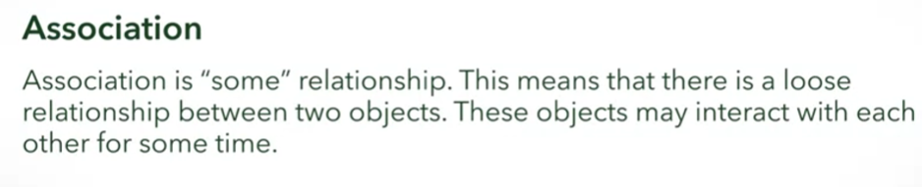
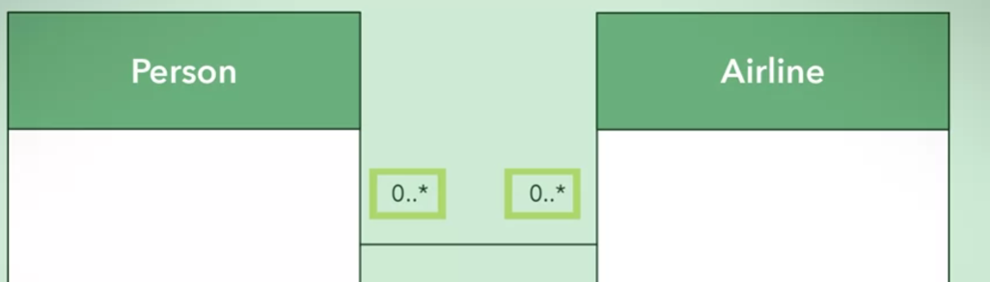
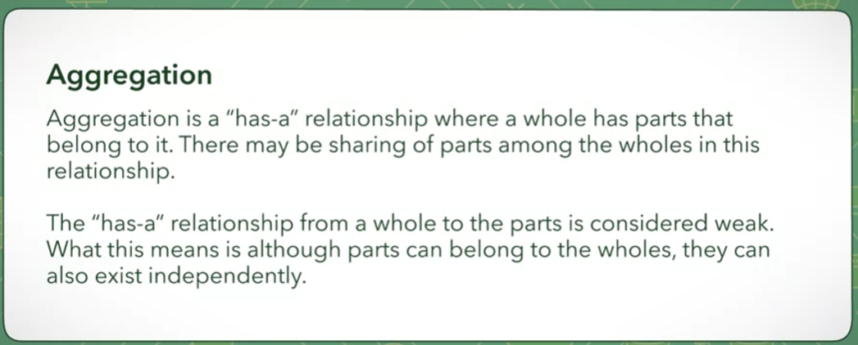
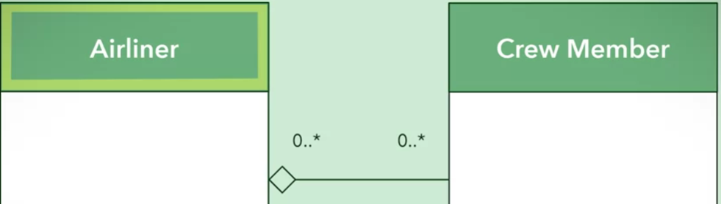
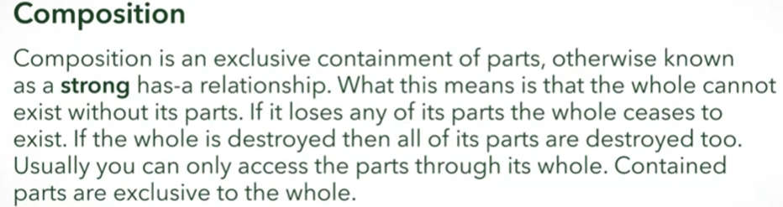
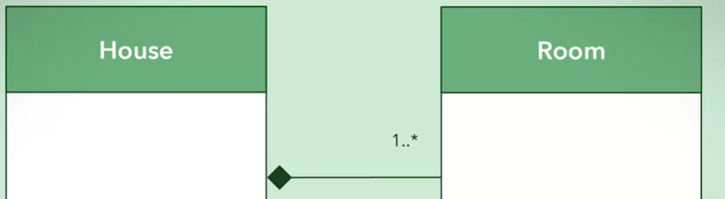
Pillars of OOPs
Abstraction
the concepts of hiding the details & complexity of the object & just exposing the object’s functions & attribute to the end user which he can use without has to care about the code & complexity of functions & attributes.
We often show the class UML diagram to user which just have functions & attribute names rest all details are abstracted
Encapsulation
this is to protect the data so that the user don’t end up messing with it , the main practices we do to implement encapsulations is access specifiers & getters and setters etc.
Decomposition
this is to take a whole & break it into several parts or opposite , there are three types of relationship found in a decomposition
-> Association
-> Aggregation
-> Composition

Slide 27
Design Pattern

Slide 28
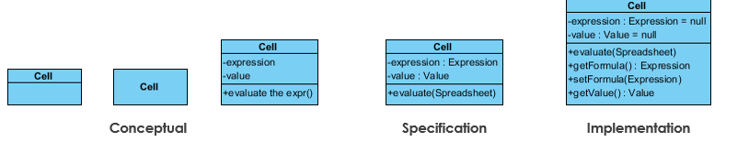
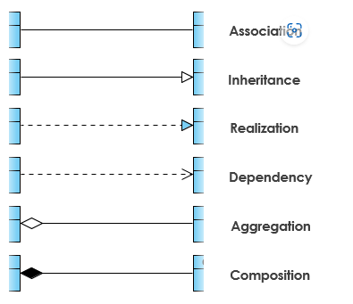
UML Class Diagram
Before Starting Design Pattern let is first Revise The Class Diagrams
We Can represent Class in 3 Level of information ,
Conceptual : just represent the Concept
Specification : Focuses in representing Specification on Abstract data type
Implementation : represent on Implementation level.

Slide 29
How Design pattern Solves Problems
We Come Across Many Problem in Day to Day life while coding :
i) Finding Appropriate Object
ii) Determinig Object Granuality
iii) Specifying Object Interface
Iv) Specifying Object Implementation
Putting Reuse mechanism
Relating Run-Time & Compile-Time Structures
Designing for Change
Let’s discuss them one by one in subsequent slides

Slide 30
i) Finding Appropriate Object
The Book Says object has Procedures (methods) & data , data represents the State of the Object , to change the data so state client need to call procedures , the data change should only be allowed through procedures not directly which conveys data encapsulation.
Procedures should have security (ie password asking etc) & constraint (you cant put height of a human as 0) on accessing & changing the data.
Client
Method
Data
object
The hard part about object-oriented design is decomposing a system into objects. The task is difficult
because many factors come into play: encapsulation, granularity, dependency, flexibility, performance,
evolution, reusability, and on and on. They all influence the decomposition, often in conflicting ways.
The Book tells Several methods of deciding how a object should be made
Write your problem statement , extract out verbs & nouns from it & Make an Object
Model the real world & incorporate it into design.
It says that design pattern helps us identify what & where things should be kept abstract , which makes the code flexible & more accommodating.

Slide 31
ii) Determinig Object Granuality
The hard part about object-oriented design is decomposing a system into objects. The task is difficult
because many factors come into play: encapsulation, granularity, dependency, flexibility, performance,
evolution, reusability, and on and on. They all influence the decomposition, often in conflicting ways.
The Book tells Several methods of deciding how a object should be made
Write your problem statement , extract out verbs & nouns from it & Make an Object
Model the real world & incorporate it into design.
It says that design pattern helps us identify what & where things should be kept abstract , which makes the code flexible & more accommodating.

Slide 32
V) Common Design/Deployment Pattern followed in Industry
Common test cases :
New Product/capability : when you are offering a new solution
Automating the manual work
Replacing previous ml system.
in all below solution the general idea is to : gradual ramp up & roll back to previous system.
Shadow mode deployment.
Canary deployment model.

Slide 33
Categorizaton of Design pattern
In This Book Design Pattern Are classified into several category
Creational Pattern
Structural pattern
Behavioural pattern
Pattern on how the objects are created
This describes various suitable relationship among objects, also relationship bw class subclass & other classes
It describes How objects distribute work , and stay cohesive towards a certain goal.
In subsequent slides we will see each design pattern

Slide 34
Design pattern : Singleton Pattern
This pattern is a creational pattern & it describes an way to create the object
As its name suggest it says that : only one object should be created for a class & only that object should be referenced everywhere (means that only that object should be globally referenced )
This Pattern is useful when we talk about some senarios where only one instance should be there
Say print queue in a Printer , configuration setting for a user etc .
But you can’t just keep track of this easily in a large application where multiple developers are working , lets see how its implemented in code for class defination.
Public class MySingleton {
private static MySingleton uniqueObj = null;
private MySingleton() {….} // constructor
public static MySingleton getInstance(){
if (uniqueObj == null){
uniqueObj =new MySingleton();
}
return uniqueObj;
}
In this code we created Constructor as Private so that it can only be called within the class
In public static method of that class, we restricted one object creation only , if that object is already created then calling that method again & again will return reference to that same class.
The syntax can change language to language also the way of implementation but the end goal is to ensure that only one object must be created.
We should be also aware of what issues it can create in what situation , eg in case of multithreading there can be a problem when threads compete for shared resources.

Slide 35

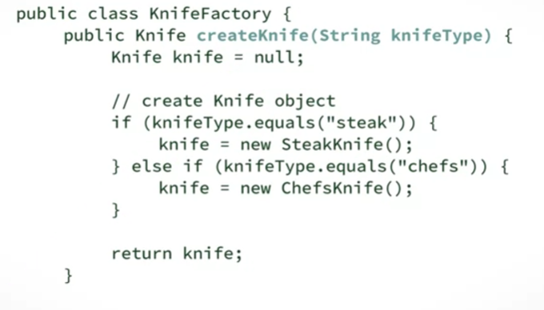
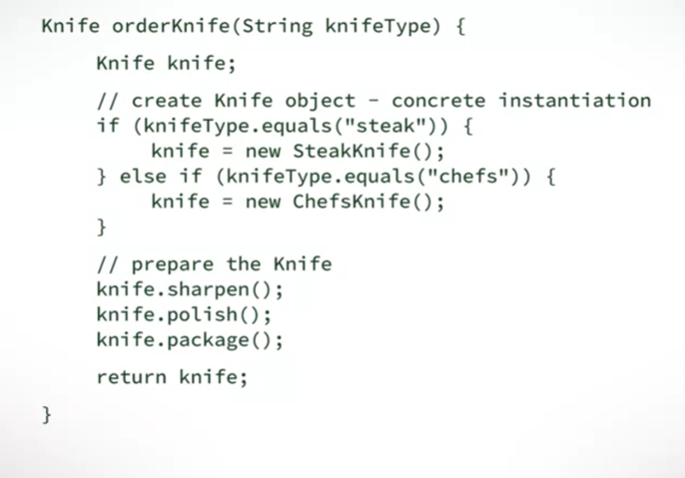
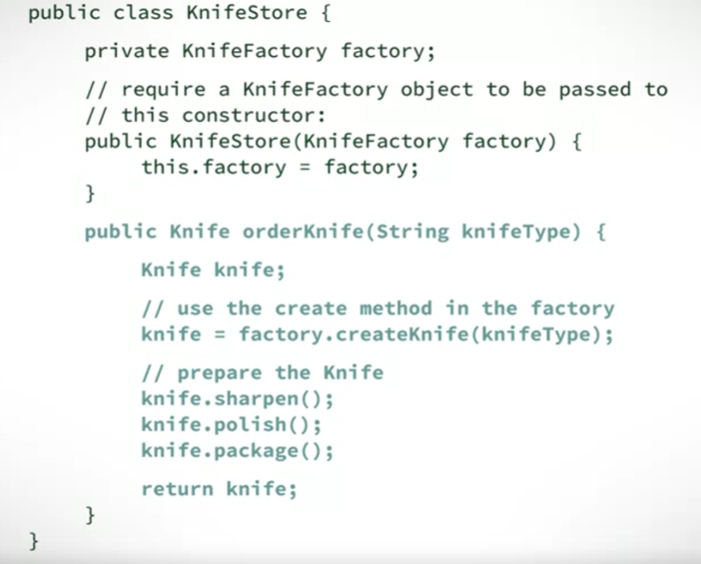
Design pattern : Factory Object Pattern
This pattern is a creational pattern , this pattern says that there should be another Factory class dedicated for Product’s concrete object instantiation, & it should be such that any class which wants that Product can instantiate that factory Class & Call its function of creating concrete class.
In the course a analogy of KnifeStore & KnifeFactory Class is Given , that how KnifeFactory Class responsible for Creation of Object , & KnifeStore Class Can just Call that Classe’s CreateKnife Function.
This Solves a problem of creation of concrete Product. Lets see the code Example !
The basic Idea is to disintegrate the
Product Creation class
From
class performing operation on product.
Think if there are multiple knifeStore ie KnifeStore1 ,2.. & if the knife Object instantiation is done in KnifeStoreN class itself then how much extra code has to be written.

Slide 36
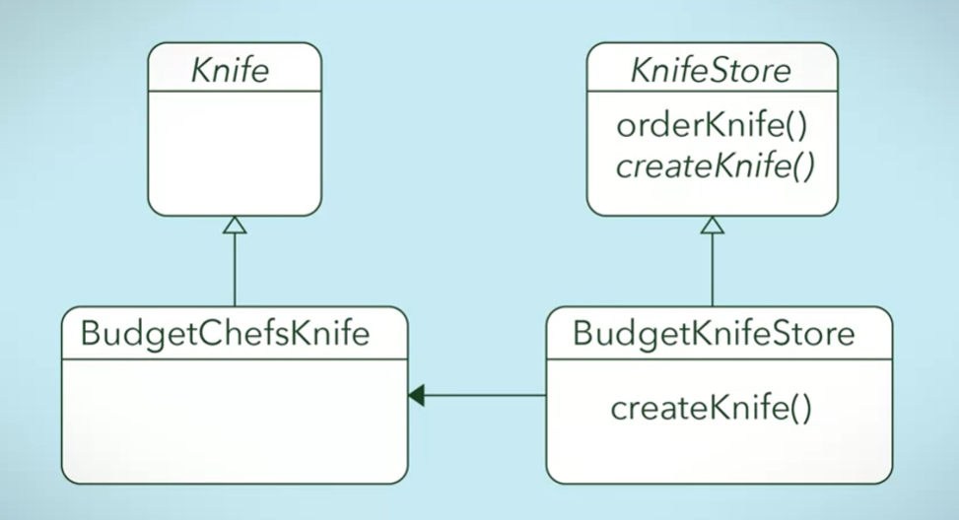
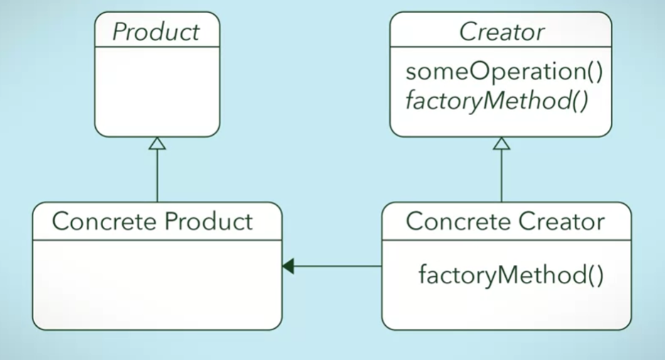
Design pattern : Factory Method Pattern
This pattern is a creational pattern , this pattern tells that in Creator also there should be a method specifically creating a product object that method we call as factory method , & Creator & that factory method should be abstract ,
The factory Method should be realised in Subclass of the Creator Abstract Class.
Lets see some images below.
Product & Creator are Interfaces
Concrete Product & Concrete Creator Are Classes
The Basic idea is that if a product again has different category & each Category has actual Concrete Product
Then creating all of that concrete Product in A single Creator is not a good idea
Rather make Creator an Abstract Class & then make a Concrete Creator Subclasses for each Category of Product
( Knife )-> (Knife Store Creator Method)
BudgetKnife -> budgetKnife Creator
ChefKnife –> ChefKnife Creator
CheapKnife -> CheapKnife Creator
AntiqueKnife -> AntiqueKnife Creator
The Combination Of Factory Object & Factory Method Creation pattern Can be Used as per the Need

Slide 37
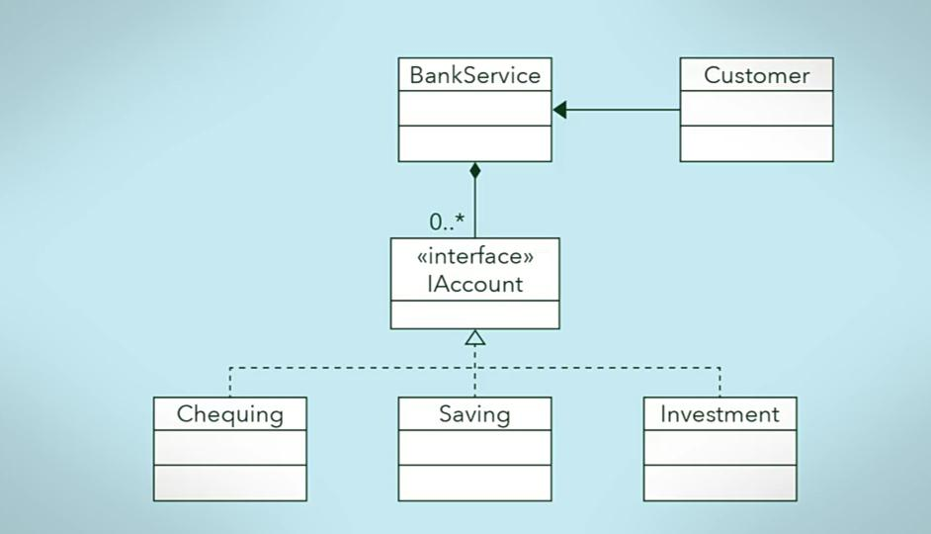
Design pattern : Facade Pattern
This Pattern opens up the concept of Wrapper, the Façade class is one which hides the implementation details from clients & provides a simple interface for client to use , A façade Class Can be used to wrap all interfaces & classes of a subsystem to present it in simple form to the client or client code , also façade calss can serve as information hiding tool .
Façade can Wrap entire System its our call to take on what has to be wrapped & whats to be left.
Below we will see an bank analogy example , where how managing the account is getting simplified with facade class.
In this Example the idea is to Create a Account interface Create subtypes of it ie different account types , & then use a façade class (BankService) to represent that entire subsystem to Customer.
so that the customer or Client wont have to implement all the functions & manage account types ,no of accounts etc .
Client Can simply call the BankService Class & use the BankService.

Slide 38
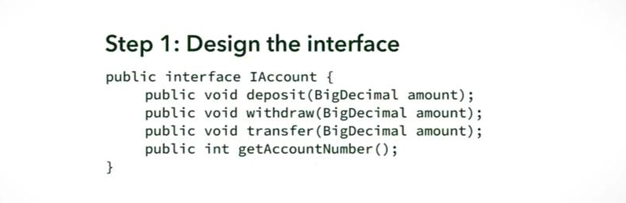
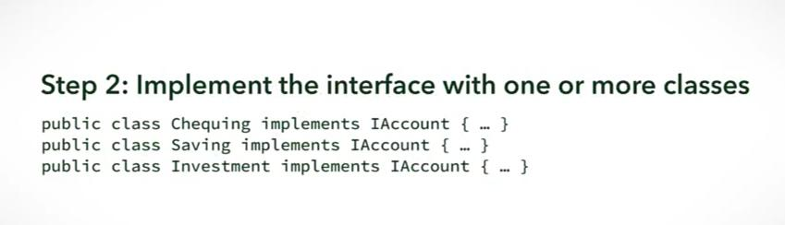
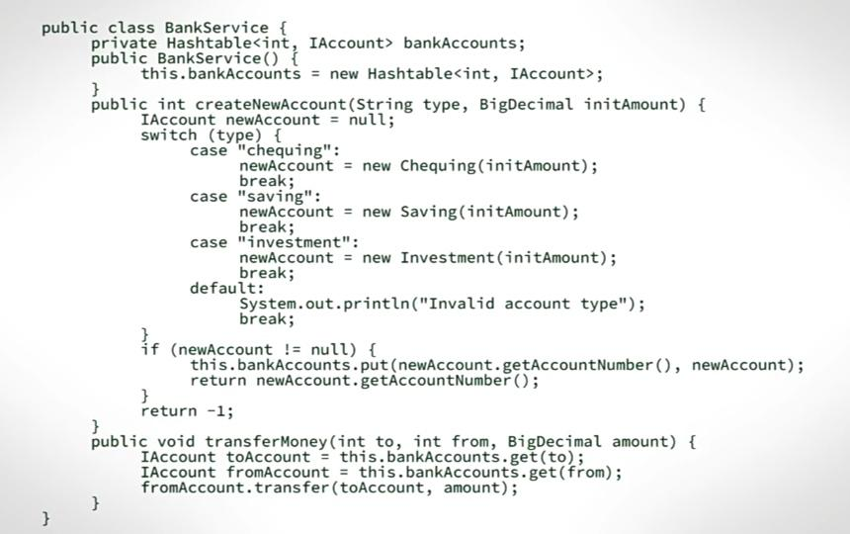
Lets have an interface Account. Which will be implemented By subtype of account eg .
Saving , Investment , Chequing Account etc.
See How the BankService Class is Wrapping all of it & Providing APIs which Can be called with simple inputs & services for the bank can be used.
It is maintaining list of all the bank accounts available
Providing API to Create a Bank Account with checking if the account already exists
Providing the API to Transfer Money , Wrapping the Transfer API of IAccount interface
& many more APIs Can be Added to simplify things for Client code

Slide 39
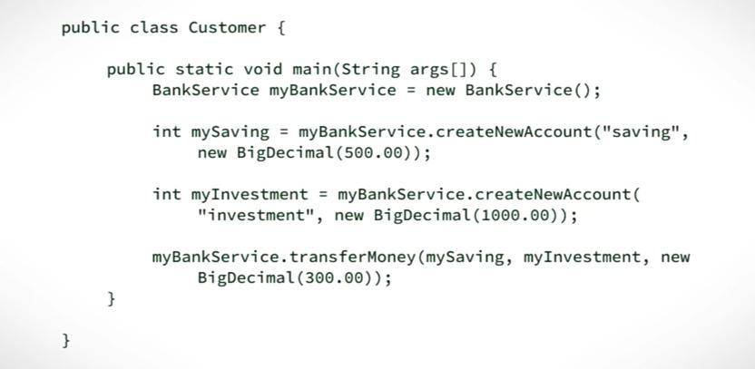
See how the BankService Façade Class has made the things easy for the client code.
Client code just need to
Create a bank service
Make accounts
And do operation among accounts
Easy peasy

Slide 40
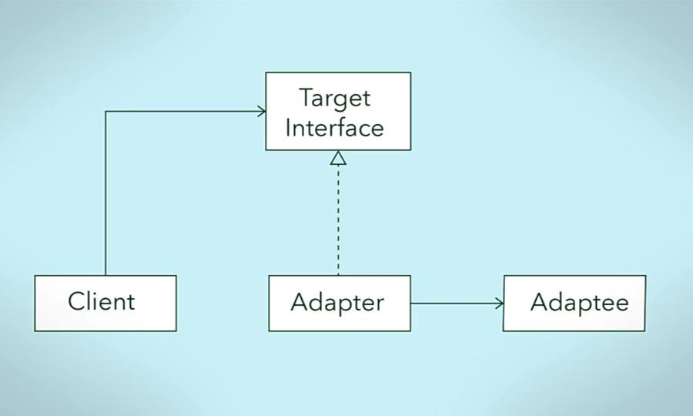
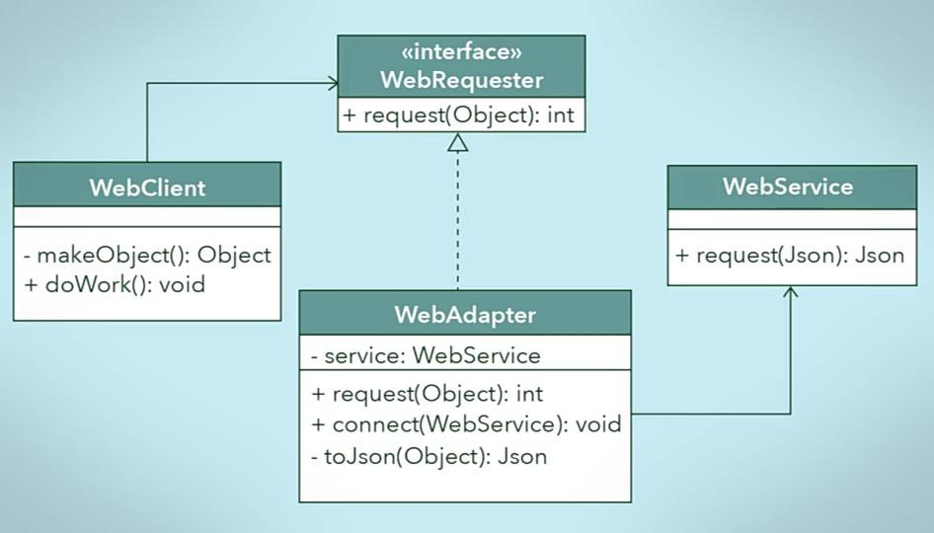
Design pattern : Adapter Pattern
As the name says it is connector bw two things where output of one cant be directly given as input of others because it as different forms.
There are situations where we need to make a layer bw two systems to communicate bw that , that is a adapter pattern.
We will see one of the way it can be implemented in.

Slide 41
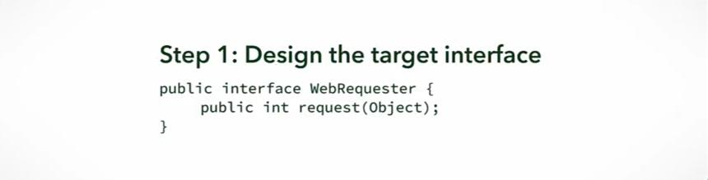
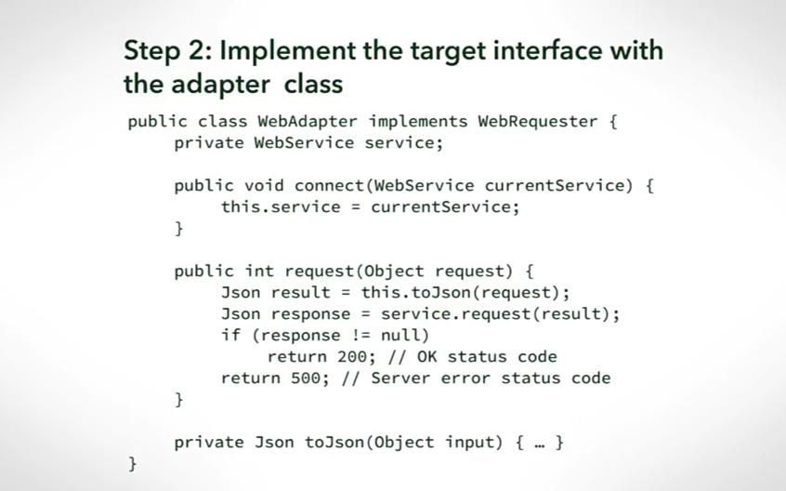
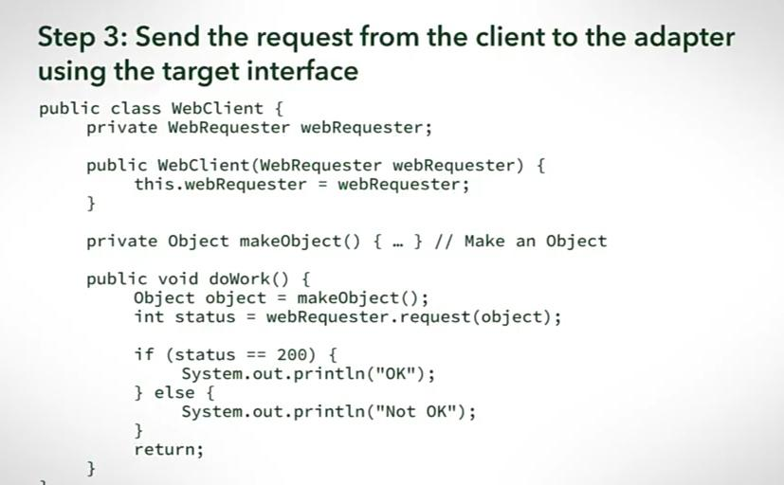
nkjdnekdj

Slide 42
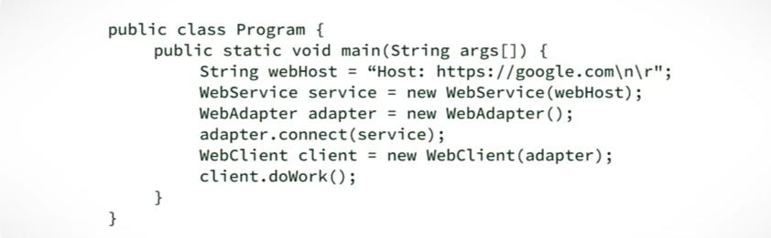
nkjdnekdj

Slide 43
Statistics

Slide 44
Statistical Distribution
S(x)
S(x)
x
x
X : x is a data point.
S( x ) : S(x) is any statistical calculation on X
it can be.
N(x) : number of x (5 children are found to be in age range 3-6, 5=N(x) )
P(x) : probability of x
SD(x) : standard deviation of x
etc
If X is a continuous value, then you will get a smooth line , otherwise it will be a histogram.
Smaller the bin in histogram , joining their tips will give smoother curve

Slide 45
Central Limit Theorem
S(x)
x
Support Vector machine Basically finds up a line / Plane / Hyperplane to classify , though it can be used for regression as well

Slide 46
Central Limit Theorem
Support Vector machine Basically finds up a line / Plane / Hyperplane to classify , though it can be used for regression as well

Slide 47
Machine Learning

Slide 48

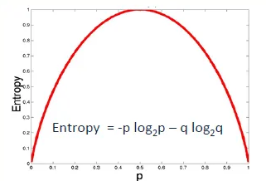
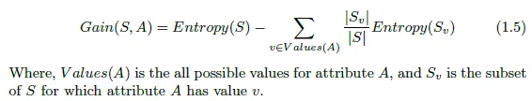
Decision Tree Classifier
Decision tree classifiers are very powerful & fast classifiers , it give inference faster & are very fast to train
When a decision tree is trained there are no of decisions we need to make given as follows
Which feature should be used in current node to split the training.
When to stop training. (it can be based on tree depth , or accuracy increase , )
Training Process
In every step of training we have to decide based on which feature we need to partition the data , &
that we decide using information gain.
We decide node based on information gain .
Information gain is the : (entropy of parent node – weighted sum of entropy of children nodes )
P Is the ratio of ( member of desired calss / total example ) , ie in a node we have 100 animals in which 30 cat 70 dogs & cat is the desired class then P+ = 30/100 & P- = 70/100

Slide 49
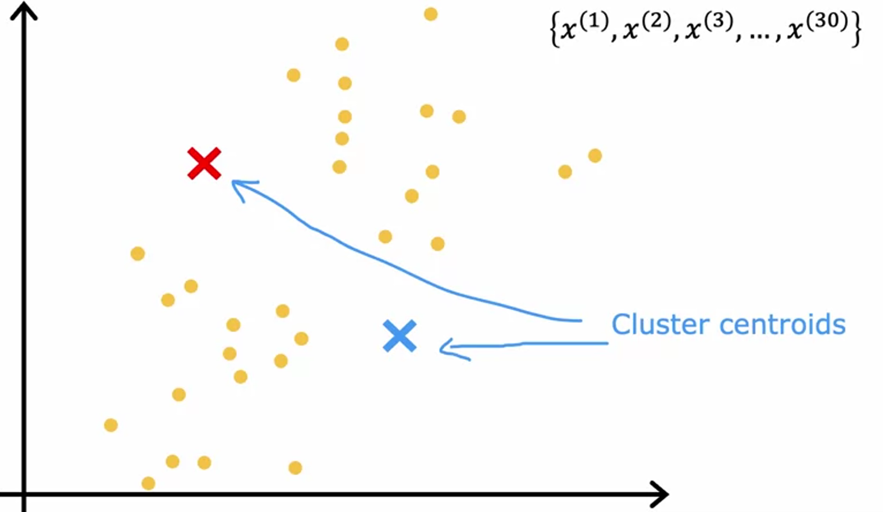
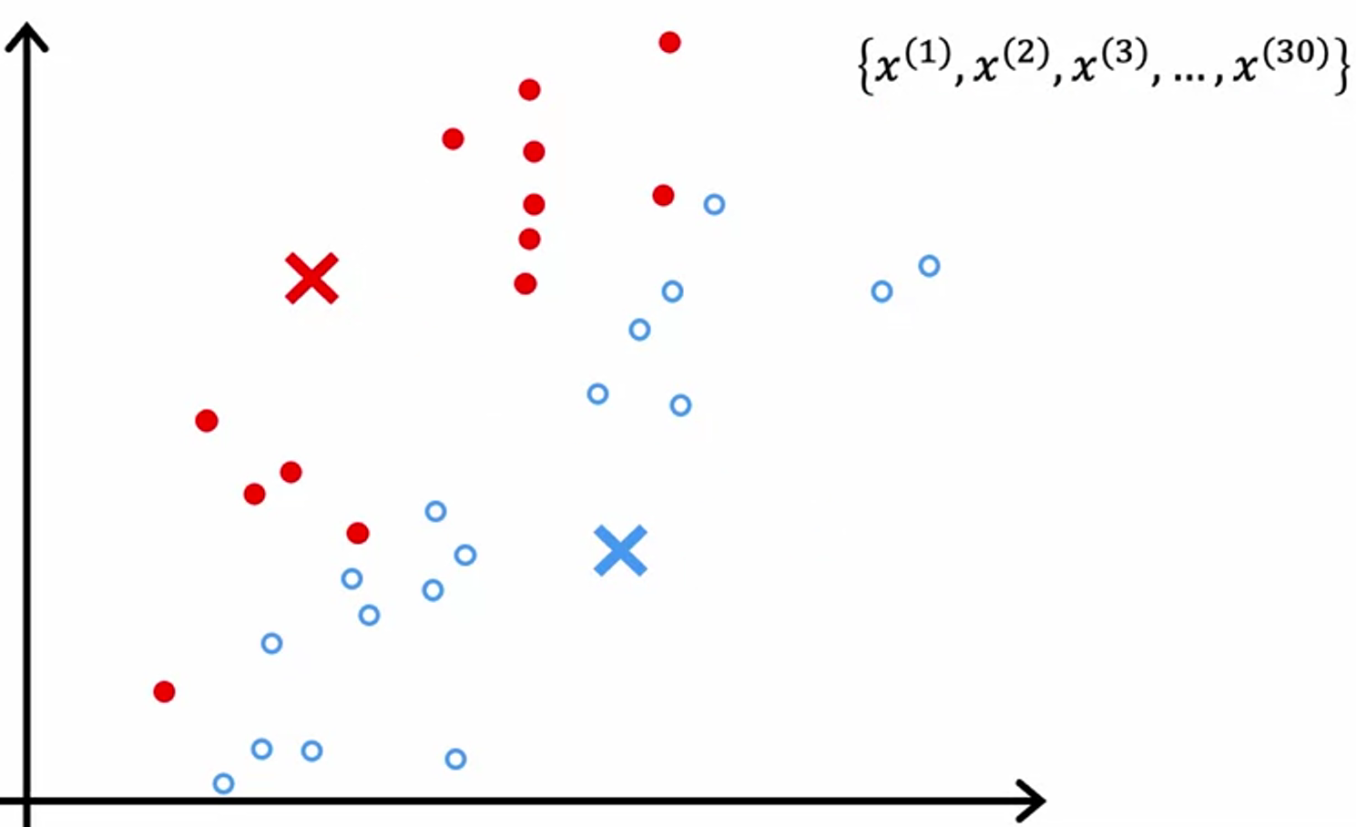
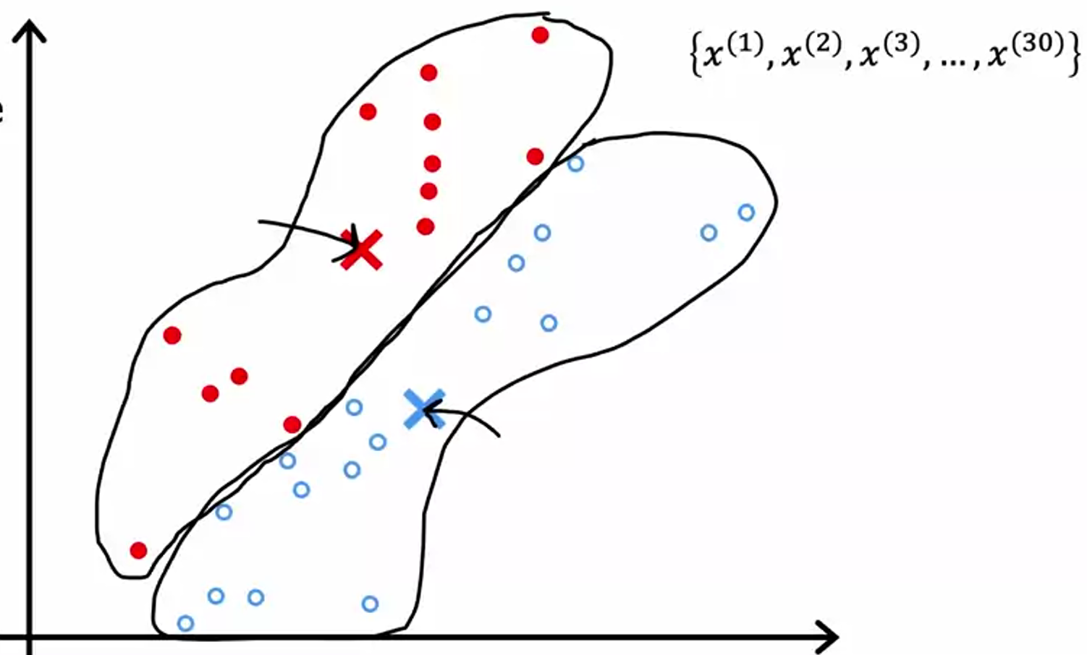
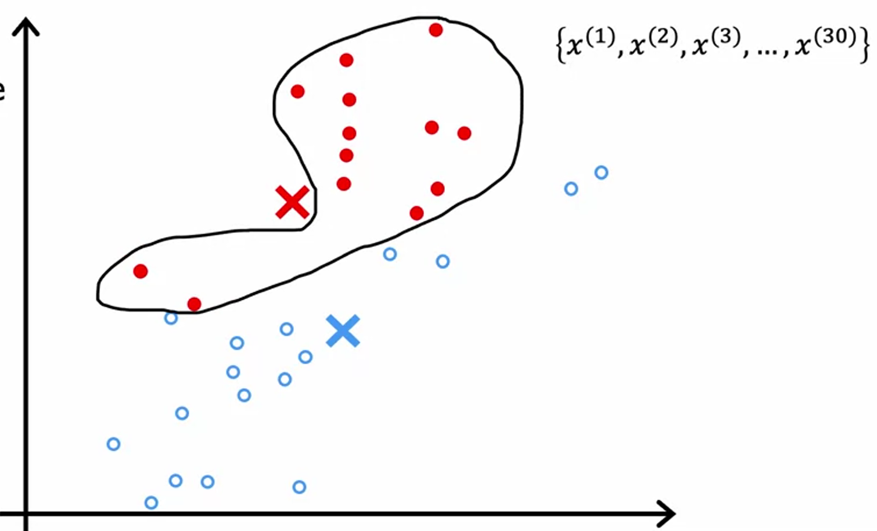
Clustering (K-means)
Clustering is an unsupervised learning algorithm , here we will be seeing K means clustering , it is very simple lets see intuition behind K means below
Training Process
We start with k clusters by taking K random cluster points on hyper graph
Then we calculate distance bw a data point & all the K points , this we do for all the data points.
To whichever cluster point the data point is near to we put that point in that cluster.
Now after assigning a cluster to all the point , we calculate average of all the point in a cluster & move the cluster point to that average point
You will observe that the distance bw data points & the cluster points are now changed , & lot of points now got near to other cluster point than their own cluster point , this will lead to change in cluster for a data point.
We keep repeating the above 4 steps till no of data point migrating to other cluster reduces below certain threshold.
Initializing random cluster
Calculating distances & putting the point on cluster
moving the cluster centroids to centroid of all the points in that cluster (recalibrating)
again re-calculating the distances &
re-clustering the points

Slide 50
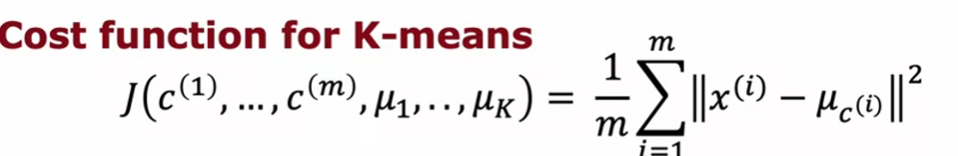
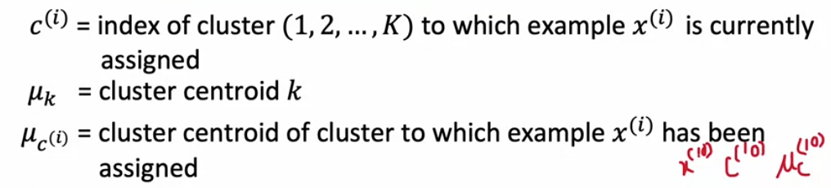
Clustering (K-means)
We will see what decision we need to take while training & also the cost function we will try to minimize
There are few decisions we need to take while training
1. How to randomly initialize the cluster centroids
2. How many number of cluster we need to have
First lets see the cost function (which is not gradient descent )
-> Take distance bw data point & its cluster centroid (for all the data points) -> sum up the squares of it -> mean it with number of clusters
-> btw the J would be minimum for a cluster if the cluster centroid would be at avg of all the point which are in that cluster

Slide 51
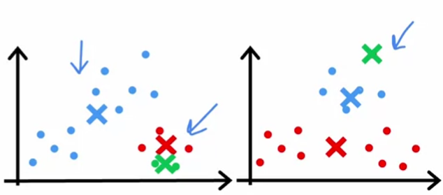
Clustering (K-means)
How to initialize cluster centroid
One of the method to initialize K cluster centroid is to take random K data points from the dataset & take them as centroids & initialize .
In some cases this method can lead to local minima as below , where both the initialization is leading to local minima
To solve the above problem we do multiple random initialization (say N times) & then create a cluster model with all different initialization & see for which of the model we are getting minimum value of K
In real time project N can vary form 50 – 1000

Slide 52
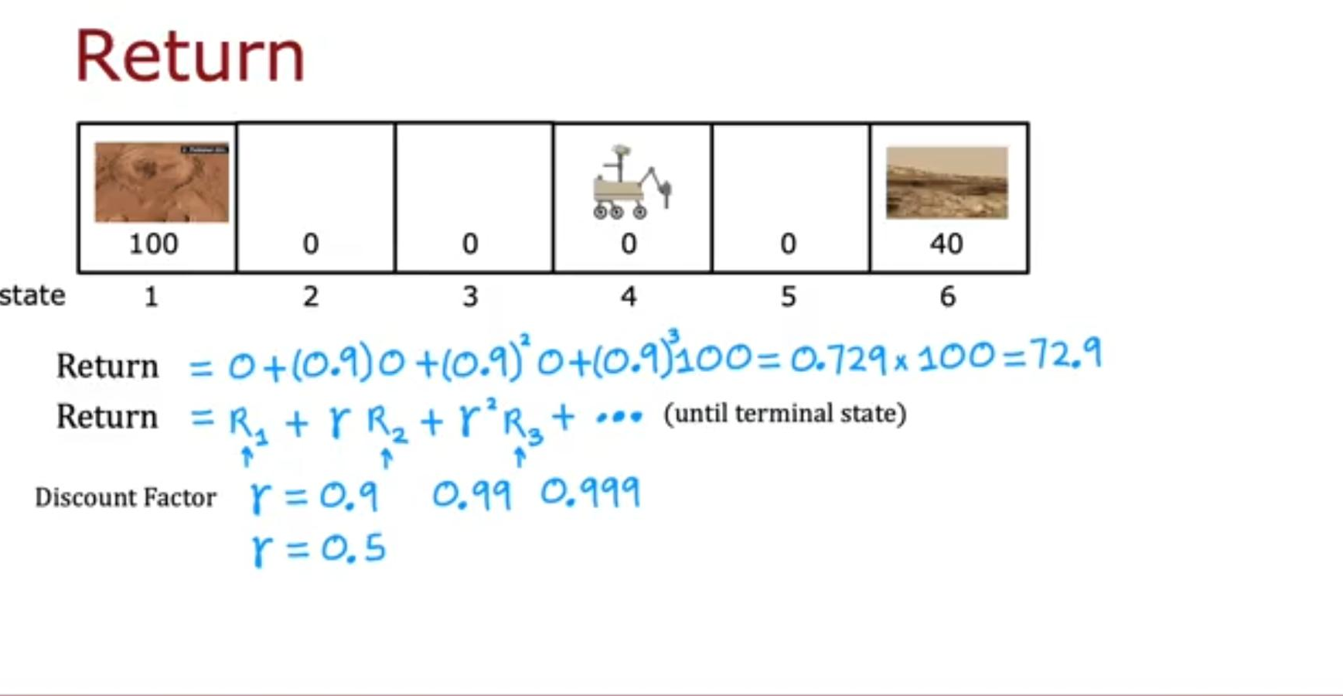
Reinforcement Learning
The goal of the RL is to come up with the Policy function. Policy function maps state with action to be taken.
The policy ensure maximum Return
the return is the sum of all the rewards multiples with “discount factor ”.
The aim of reinforcement learning is to give the system +ve or –ve reward based on if the state is desirable or not desirable
Basically every state in RL has a reward , & then a action is taken from that state to go to new state this is represented as
(S , A , R(S) , S’ )
S - current state
A – Action taken
R(S) – reward from the current state
S’ – new state after taking action
Think of you getting 5$ now vs you getting 10$ after a year , what state you would prefer to be in
If you think its better to get 5$ now. for implementing this in RL we bring a system where the reward points value decay with effort to reach to a particular reward.
This decay constant we call as : Discount factor
in practical cases discount factor will range from 0.9 -0.99
Lets see a mars rover example given in the lecture
Say the rover is at 4th state for it to go to 1st & get the reward points 100 it has to go through state 3,2
so farther the state is more the power of discount factor multiplied with the reward of that state
This will kind of make the algorithm impatient
We will calculate return which is sum of reward multiplied with appropriate power of discount.

Slide 53
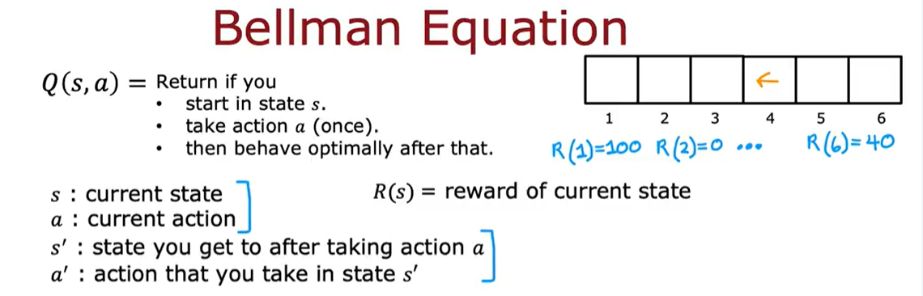
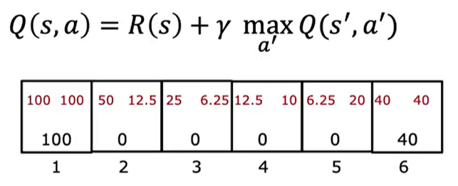
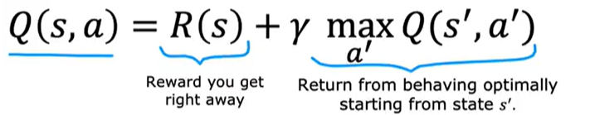
Reinforcement Learning
Now there are multiple ways in which we can decide what action to take from current state , for this we have to have a function which maps the current state with the action to be taken
We call this function Pi(S) , we use term “Policy” for this function.
The goal of the RL is to come up with the Policy function.
Gamma : discount function

Slide 54
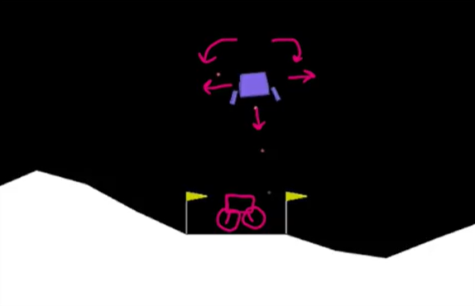
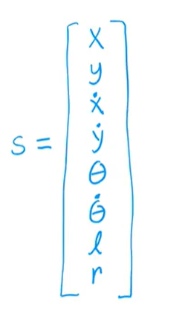
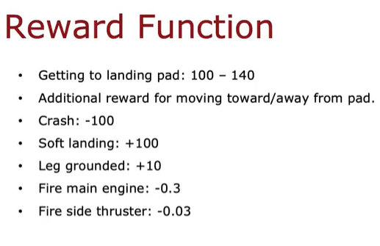
Reinforcement Learning
Lets take lunar lander example
The goal is to land the lander on landing spot
While doing this it can perform certain actions & reach certain states lets define them
The state of lander is defined by below variable
-> Below given a reward function , reward function is designed by programmer based on what behaviour is expected from system
Our goal is to learn a policy function pi ST when given state S we get action a
a =pi(S)

Slide 55
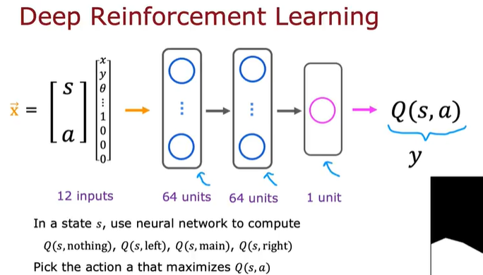
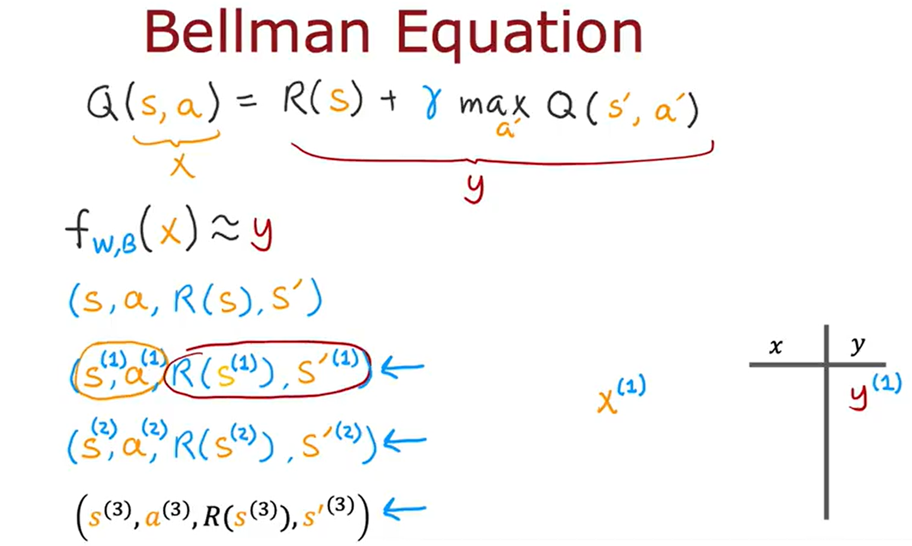

Reinforcement Learning
Training lunar lander

Slide 56

FineTuning Reinforcement Learning
Improved Architecture
In this we need to do inference 4 times to get Q-value for all the four actions
Only once inference is enough to determine Q for all the four values

Slide 57

FineTuning Reinforcement Learning
Exploitation & Exploration
When we start training the Q is new (randomly initialized ) & hence we shall not take all the actions based on Q , we also need to take random action which can be seen more as exploration to new states which Q (noob Q) might thinks as not of max return .so that Q can improve with each iteration
Epsilon : proportion of action taken randomly.
Epsilon can be set high initially to let the system explore as much as possible then slowly the Q starts to become more matured & we can gradually start exploiting Q more .

Slide 58



SVM
Support Vector machine Basically finds up a line / Plane / Hyperplane to classify , though it can be used for regression as well
Hyperplane
Support vector : all points which falls on or under margin line is called SV
First comes maximum margin classifier then support vector classifier (soft margin classifier) then support vector machine.
MMC aims to provide the hyperplane which has maximum possible margin from support vectors
Support vector classifier : MMC overfits the data sometimes in below case ,but SVC handles it by fitting the training data less e.g. allowing for few misclassification in training data.
margin
Support vector
SVC
MMC
Support Vector Machine : but what we will do in below case , none of the above 2 will work in below case.

Slide 59
Neural Networks

Slide 60
W
L
n
4
2
3
4
2
3
1
m : no of data points
n : no. of attribute in input data
A : output from Lth layer
W : weight matrix
L : Lth layer
n
4
2
3
1
m
m
m
m
m
L
A

Slide 61
Forward Propagation
l
l-1
l
a = f (w x a + b )
Where f() is a function
l
Layer 1
(4,m) = (4, n) x (n, m) + (4, 1)
Layer 2
(2,m) = (2, 4) x (4, m) + (2, 1)
Layer 3
(3,m) = (3, 2) x (2, m) + (3, 1)
Layer 4
(1,m) = (1, 3) x (3, m) + (1, 1)

Slide 62
Forward Propagation
How dimensions are
L
W = (l , l-1)
L
A = (l , m)
L
B = (l , 1)
l : no of neuron in l th layer
m : total no of data points
(notations can vary book to book)

Slide 63





Activation Functions
https://medium.com/anolytics/activation-functions-and-loss-functions-for-neural-networks-how-to-pick-the-right-one-542e1dd523e0
i) Sigmoid : sigmoid is majorly used for binary classification
i) tanh

Slide 64
Loss functions
i) Sigmoid

Slide 65
Generative AI

Slide 66



Introduction & Intuition
2 models competing bw each other , one would try to generate data as real as possible & another classifies the generated data as real or fake.
The gerenaerator & discriminator pair
The discriminator is basically a classifier & generator
training Cycle
Discriminator training
Generator Training

Slide 67
Neural Networks (HyperParameter Tuning & Normalization )

Slide 68
ii) Understanding Train/dev/test set
The Train set is to train (obvious) , the dev set is to compare the different models after the training to find out that which model is working better & filter out , & the test set is to find unbiased accuracy of selected model.
Traditional ratio is 60/20/20 but if the data is in millions then this ratio is absurd as only few thousand points are required In dev & test set, hence the ratio would go down eg 99.5/0.25/0.25 & so on.
One more thing to keep in mind is that the distribution of train & dev/test data sets should be same, eg if we train on images of Cat which are high resolution & then test the model on user data which has often pixelated & not so well clicked images , this should not happen.

Slide 69


iii) Bias variance & its tradeoff
The Bias happens due to underfitting of data & Variance from overfitting of data.
The above picture is in 2D but in higher dimension we wont be able to visualize boundary. Hence lets see how to analyze bias and var using some values
One way to analyse is to check accuracy in Train & Test set, see example given below , below example assumes that human level error is nearly 0%

Slide 70

iii) Basic ML recipe

Slide 71
iii) Basic ML recipe

Slide 72
Neural Networks (Project Structuring)

Slide 73
I ) Introduction
In a neural Network Project you have to deal with quiet few of the hyperparameters, there should be a proper structure to carry that out , we will be learning about it in subsequent slides.
You have N no. of thins to change in an NN project like,
Should I collect more data.
Should the training set be more diverse
Should I train algorithm longer
Should I change optimization method eg Gradient descent to Adam or vice versa.
should I change network size
Should I try Dropout normalization or L2 normalization ,
Should I tweak something in network architecture eg
Activation function ,hidden units , etc
In this we will diagnose what is the bottleneck & what needs to be changed to achieve what
II ) Orthogonalization
Think it in terms of knob ,
In concept of orthogonalization the notion is that it is better to work with parameters (knob) which affect only one of the outcome in the model
Eg knob which just adjust he screens width & knob which just affect the Screens height that is good , but knob which affect the height & width simultaneously is hard to handle.
We can say each knob should affect the things orthogonally.
Basic Chain of assumption in ML
Fit training Data well -> model should perform well on dev/Cross val data -> model should perform well on test data -> model should perform in real world
In any stage in above ,if the model don’t do well then we have certain set of knobs to tweak & that knob should be orthogonal .

Slide 74
III ) Human Level Performance & why we Compare Models with it.
The Human level Performance is a mark using which you can anlyze accuracy of your model.
Bayesian optimal error :
Bayesian Optimal Error
Accuracy
Human level performance
Time
It is error from a Bayesian line which will remain how hard you try or how much ever longer you train the model, mostly the line for bayesian error lies very near to Human level performance.
It has been observed that the accuracy increases rapidly before achieving human level performance but then it gets slow increment

Slide 75


III) Regularization
We have seen regularization with normal machine learning model in this ppt we will see L2 Regularization, which we do by adding forbenius norm in loss function
Basically the Forbineus theorem is the sum of square of all element of an matrix :

Slide 76
TensorFlow

Slide 77

II) Lets get started
Then you compile the model using optimizer & loss function
First you declare layers in Model
Then fit the model with data

Slide 78
II) Useful materials
Playground for NN :
http://playground.tensorflow.org/#activation=tanh&batchSize=10&dataset=circle&regDataset=reg-plane&learningRate=0.03&regularizationRate=0&noise=0&networkShape=4,2&seed=0.27173&showTestData=false&discretize=false&percTrainData=20&x=true&y=true&xTimesY=false&xSquared=false&ySquared=false&cosX=false&sinX=false&cosY=false&sinY=false&collectStats=false&problem=classification&initZero=false&hideText=false
Classification of MNIST dataset Colab notebook:
https://colab.research.google.com/github/https-deeplearning-ai/tensorflow-1-public/blob/version_3/C1/W2/ungraded_labs/C1_W2_Lab_1_beyond_hello_world.ipynb

Slide 79

III) Callbacks
We sometime require to perform something if something happens, this we call as callback function

Slide 80
TensorFlow
(Advanced)

Slide 81

I) Functional APIs
Functional APIs are the one which helps us to create branched neural networks, its syntax is given as follows,
We define each layer as a function call which in turns returns a function which we can call & pass the previous layer ,
We start with input layer & ends with output layer , in each call we pass number of neurons & activation function.
Then finally we pass input & output layer in Model() API, this will create the model

Slide 82



II) Functional APIs
This is an example of multi output network , see in Model() API we have given 2 outputs in a list form , this is how the syntax is.

Slide 83




II) Functional APIs
Now we will see example for multi input neural network,
This is to compile the model

Slide 84
II)Custom Loss Function
Now we will see how to make custom loss function in tensorflow
This is to compile the model

Slide 85
MLOops

Slide 86

I) Introduction
In a ML Project Only 5-10% of Code is Written For ML Model , rest all is different codes (see below img)
The Model giving correct Prediction is Just POC
A Complete Process of Deploying a ML Model into Production is known as MLOops
Machine Learning + software Engineering = MLOops

Slide 87
II) ML Project Life Cycle with Case Study
Case Study : Speech recognition
Linear belt
Linear belt
Robot’s
Base
Robot’s
Base
Current Positioning
Previous Positioning

Slide 88

i) Problem Machine learning model face
Statistical issue
Software engine issue
Statistical issue
a) data drift : change in data after the model has been deployed, new species of flowers are started evolving etc
b) concept drift : lets say certain data in a market basket in a certain quantity would be considered as fraudulent before
covid but after covid that had gotten normal , or certain size of house had certain price , but today I this changed.
so, basically concept drift is How the mapping Bw input & output changes.
Software engine issue
The first deployment is just half of the ML life Cycle & the maintenance is another half

Slide 89
Quantum Computing

Slide 90
I) Understanding Single Quantum System using Classical System
Let a system be X ,X can be in one of the state from ∑ ,
eg
X be a Binary System then ∑={0,1}
X is 6 sided die ∑={1,2,3,4,5,6}
Lets say because we are uncertain about the state of classical system (for xyz reason) we represent all the states through Probability
pr( X =0) = 2/3 pr(X=1) = 1/3

Slide 91





I) Unitary & Hermitian matrix
This is conjugate of a matrix
This is transpose of an matrix
This we call as A dagger
This is unitary matrix , matrix for which U cross U dagger is equal to identity matrix, this says that unitary matrix has a inverse always , hence it is a revesible operation
Hermitian matrix

Slide 92

II) Eigenvector & Eigenvalue
A is Eigenvector & lambda is Eigen value
Eigen vector : if you multiply a vector with eigen vector that vector don’t change its direction rather it will be scaled in same direction.
Eigen value : the number by which a vector is scaled is called eigenvalue

Slide 93



II) Introduction to Qubits & Superposition
Classical Computers store data in 0 or 1 , QC uses Qubits (quantum bits ) , a Qubit can be made from any quantum particle that has 2 distinct state
Dirac notation
The 0 & 1 is represented as column vector , the upper element gives the probability of particle to be in state 0 & the lower gives that of 1

Slide 94




II) Measuring of a Qubit Basic

Slide 95


II) Intro to Dirac Notation
The brackets around 0,1 & phi is called “ket” , all it tell is that 0,1,phi are quantum states

Slide 96






II) Qubit graphical representation

Slide 97





II) Qubit graphical representation
Note

Slide 98




II) Gates
How we have XOR,OR,NOR gates in classical computer in a similar way we have X Y Z gate in quantum computers
Applying any of the gate rotates the quantum vector on block sphere by 180 degrees
To represent gate in terms of matrices

Slide 99
Applying Z gate will change the probability of 1 & 0
While applying the X , Y gate changes the phase , it doesn’t change the probability
you might be wondering what phase is , we will see it in short while.
To represent gate in terms of matrices

Slide 100



Slide 101

II)Introduction to global phase & relative phase
The relative phase rotates the Qubits around Z axis
The global phase is logically irrelevent
Relative phase doesn’t change the probability of getting the 1 or 0 state in a qubit

Slide 102


II) Hadamard Gate
At the equator of bloc sphere we have 4 states , with each state having equal probability of getting 0 or 1
+ , - , i , -i
You see after applying Hadamard gate the vectors with different relative phase , went into different probability of 0 or 1 , even though initially all the vector had same probability of 0 or 1.
The Hadamard gate make power of relative phase realised.

Slide 103

II) Hadamard Gate
Example of applying Hadamard gate on a qubit

Slide 104

II) S & T Gate
Let’s see S & T gates

Slide 105


II) Tensor Product

Slide 106


II) Tensor Product

Slide 107


II) Tensor Product

Slide 108







II) Quantum Circuits
This are the state of qubit after every operation
This we call as quantum circuit each row represent a Qubit & each column represent one operation on that q bit (phi)

Slide 109






II) Multi Qubit gate
CNOT : (Controlled Not Gate)
it inverts the target bit if control bit is 1 , else do nothing

Slide 110


II) Multi Qubit gate
Toffoli Gate
Same as CNOT but has 2 control Qubits & one target bit

Slide 111
II) Multi Qubit gate
Toffoli Gate
Same as CNOT but has 2 control Qubits & one target bit

Slide 112





II) Measuring Qubits
When we measure than the superposition state would collapse to that of measured one , so the above one would collapse to :
We get rid of all the qubits for which second qubit was not 1.
But wait for this collapsed state the sum of probability is ¼ but it should be one, hence we multiply a number so that the sum of probability again becomes one.

Slide 113

II) Measuring Qubits

Slide 114





II) Entanglement & Bell States
Lets see what is Entanglement , so lets start with a superposition state |00>
If you observe if we measure any of the Q bit in this , we can be sure about other qubit
Like if we say we want first qubit as 1 ,
In the result we can be sure that the other qubit would also be a 1.
Ie the 2nd qubit is entangled with 1st

Slide 115


II) Entanglement & Bell States
This state is not entangled as it can be factored to individual Qubits
While this state is entangled , you can see if we go for last qubit as 0 we will get first as 00 for sure, & if we go for last qubit as 1 we will get first 2 qubit as 01 for sure.

Slide 116


II) Entanglement & Bell States
There are two types of entanglement
i) maximally Entanglement
when the other qubits can be 100% certain , based on measurement of a qubit
Bell States

Slide 117

II) Entanglement & Bell States
There are two types of entanglement
i) Partially entanglement
when measurement of one Qubit affect the amplitude of other Qubits

Slide 118









II) Phase Kickback
This we call as phase kickback

Slide 119




II) SuperDense Coding
Alice has 1st qubit & bob has 2nd qubit, hence Alice will apply operations on 1st & bob on 2nd
Alice Side
Bob Side

Slide 120

II) Classical Operation Prerequisite
We see that in classical bits we apply gates like OR, AND, XOR, NOT etc . Here we see that not all gates are reversible operations , we will try to see in this that how we can come up with a function which is reversible
Given output as 1 we cant say whether the input was 00 or 01 or 10.
hence this function is non-reversible c
Here if we get the output we can certainly say the input

Slide 121



II) Classical Operation Prerequisite
We observed the following
Taking XOR of F(x) with one more input “c” will give you , a reversible operation
Input : x , c
Output : x , c XOR f(x)
XOR
Let’s take the example of OR operation
You can see for every output there is unique input

Slide 122
II) Classical Operation Prerequisite
We will see how we can come up with reversible operations in QC ,
The operation we apply on quantum computer must be reversible, hence the function we apply must be reversible .
We use the technique in previous slide to come up with reversible functions for QC also

Slide 123


II) Standard Quantum Function / Oracle
We will see how we can come up with reversible operations in QC ,
The operation we apply on quantum computer must be reversible, hence the function we apply must be reversible .
We use the technique in previous slide to come up with reversible functions for QC also
Any bit XORed with 0 will give the same bit

Slide 124
WSL to Visual Studio

Slide 126
Cam to A6 Rotation : what rotation we are giving to cam with respect to axis protruding out
Distance Bw Cams

Slide 127
Retrieve Sequence
Objective:
Retrieve Sequence Should Bring the System to home Position from any of the intermediate Position of Forward Sequence.
We should have Minimum length of retrieve Sequence, Retrieve Sequence should be a subset of reverse command list
Challenges :
1. We Can’t directly give the Arms move home Command as there could be possible issues
a) we are not sure how the Arm’s Body would move from any position to home position hence there could be possibility of collision. So,we cant just directly send the move commands
b) also if the arm has the object , we need to place it somewhere first, then only we can go to home.
2. When both the Arms is in working space we cant just move one arm as per the wish , chances of collision would be Higher.
3. We can’t just directly do all reverse, as it would be very absurd if sequences are long.
4. We should also Identify that would the system reach “Home State” faster if it goes forward or if it goes backward.
5. We need to identify 3 kind of commands while adding command in Reverse command list
i) which can be directly kept into reverse command list.
ii) the command first itself need to be reversed before keeping it into reverse command list. Eg open gripper , close gripper & any robot commands of such nature.
iii) command which cant be kept in reverse command list .

Slide 128
SHIRI
Foods
मठरी
MATHRI
Chatpata
Order @ 9829992279

Slide 129
Proposed Solution 1
As we know that the head going to home position don’t interfere with motion of any of the arm & also head’s view position is prone to get collided. Hence first command of retrieve Sequence should be to bring the head to home position.
Then there are 2 cases.
i) Both the Arm would be in working area.
in this case movement of one arm would be highly dependent on movement & position of the other arm. Hence its better to move (forward or backward) as per the reverse command list.
As reverse command list just had command of forward sequence but just in reverse order.
& we know that the Forward sequence was safe.
ii) one of the arm reaches home (say arm A).
now the arm at home shouldn’t be moved, by ignoring all command in reverse command list, which moves this arm.
any command you pass form reverse command list should be only for other arm & this has to be done till other arm also reaches to home.
But some challenges would come
-> what if the coordination with arm A is there in the RSC list.
-> what if the dropped object can’t be picked again.

Slide 130
Suggested changes in main
In cluster putting loopID rather than ID

Slide 131


Slide 132
Proposed Solution 2 :
This is improvised version of solution 1
Stride Length (60 cm)
Moving Target (150 mm/sec)
Reference Line
Belt / Linear Guide
Object Position &
offset calculation
(cycle time :70 -100 ms)
CLX Image input
Fanuc HSPO (10ms cycle time)
Sending offset (10ms)
PC
Controller (Running RMI & DPM)

Slide 134

1

Slide 135
Denso Application Flow Chart
Rotor Tending
start
Camera Robot
Check for rotor presence in rack
Right Robot
Left Robot
Pick the Rotor From center terminal & place on right terminal
Present ?
Pick the rotor from rack at respective position
Rotate the rotor for CLX to analyze it
Bring the rotor in center & pass it to right arm
Analyze , give reorientation command to right arm
Reorient the rotor & pass it to left arm
Remove the pin from center terminal& put it into bin
Take the Rotor from right arm & place it on left terminal
Place rotor from right terminal to destination
Take the rotor from left terminal & place on center terminal
Push the trigger
Move back to Home
Pick the Rotor From center terminal & place on right terminal
Tray Pick
start
Camera Robot
Look For the Object in tray
No
Present ?
yes
Determine Object coordinate
Gripper Robot
Move to clear the workspace for gripper robot
Pick the object from tray based on calculated coordinate
Drop the object in given bin
Go to standby position

Slide 137
0.25cm = 1 inch

Slide 138


Slide 140
Class : command
Cmd_name
cmd_jnt_config
Cmd_cart_pos
Robot_name
motion_type
Class : command
Cmd_seq : queue <command*>
Req_component: map <component_name_e,bool>
Session_r : CyDoosan*
Session_c: CyDoosan*
Session_l: CyDoosan*
doosan_connection_check ()
Register_components()
Add_sequence()
Add_commands()

